Slide 1
LL(1) Parsing

Slide 2
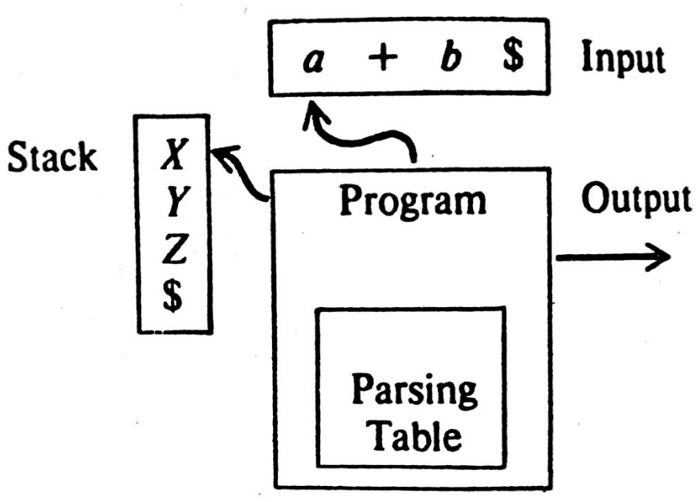
Predictive Parsers
It is an efficient way of implementing recursive descent parsing by handling stack activation records explicitly.

Slide 3
Predictive Parsers(Continued..
The working of the parser as follows:
The program determines the X(symbol on the top of the stack) and a , the current input symbol. These 2 input symbol determines the action of the parser.
There are three possibilities:
If X=a=$, the parser halts and announces successful completion of parsing.
If X=a≠$, the parser pops X off the stack and advances the input pointer to the next input symbol.
If X is a non terminal, the program consults entry M[X,a] of the parsing table M. This entry can be either X-production of the grammar or an error entry.
X→UVW then pop X from the stack and push WVU onto the stack.

Slide 4
Construction of Predictive Parsing Table
for each production A→α of the grammar, do steps 2 and 3.
2. For each terminal a in FIRST(α),add a→ α to M[A,a].
3. If ϵ is in the FIRST(α), add A→ α to M[A,b] for each terminal b in FOLLOW(A), If ϵ is is in FIRST(α) and $ is in FOLLOW(A), add A→ α to M[A,$].
4. Make each undefined entry of M error.

Slide 5
Question: Construct predictive parsing table for the given grammar: E→TE’ E’→+TE’/ϵ T→FT’ T’→*FT’/ ϵ F→(E)/id
Solution:
Calculate FIRST and FOLLOW
FIRST(E)=FIRST(T)=FIRST(F)={(,id}
FIRST(E’)={+, ϵ}
FIRST(T’)={*, ϵ}
FOLLOW(E)= FOLLOW(E’)={),$}
FOLLOW(T)= FOLLOW(T’)={+,), $}
FOLLOW(F)={+,*,), $}
Now Apply the Predictive parsing table algorithm in order to construct the parsing table.

Slide 6
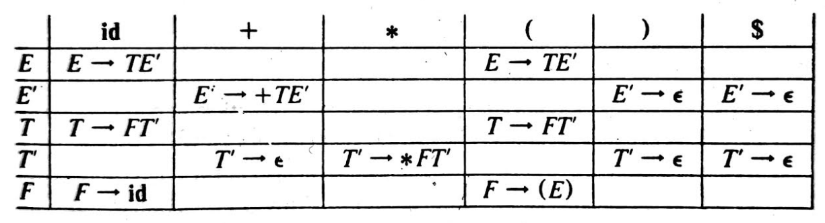

Predictive Parsing Table
Consider the First production, as FIRST(TE’) =FIRST(T)={(,id}, so the
Production E→TE’ entered to M[E,(] and M[E,id].
Consider the second production, E’→+TE’ entered into M[E’,+] and
E’→ϵ causes M[E’,)] and M[E’,$] to acquire E’→ ϵ since FOLLOW(E’)={),$}
Consider the third production, as FIRST(FT’) =FIRST(F)={(,id}, so the
Production T→FT’ entered to M[T,(] and M[T,id].
Consider the Fourth production, T’→*FT’ entered into M[T’,*] and
T’→ϵ causes M[T’,+], M[T’,)] and M[T’,$] to acquire T’→ ϵ since FOLLOW(T’)={+,),$}
Consider the fifth production, enter F→(E) to the M[F,(], and F→id to the M[F,id].

Slide 7
LL(1) Grammar
The first L means that the scanning takes place from Left to right.
The second L means that the Left derivation is produced first.
‘1’ means One input symbol at each step.
No left recursive or ambiguous grammar can be LL(1)

Slide 8
Condition for LL(1) Grammar
Grammar G is called LL(1) if and only if whenever,
If A->α|β are two distinct productions of G, the following conditions hold :-
1. (a) FIRST(α) , FIRST(β) must be disjoint. This is to be able to deterministically guess the production.
(b) At most one of the strings α or β can derive ε (Since FIRST(α), FIRST(β) are disjoint.
2. If α -> ε then FIRST(β) and FOLLOW(A) must be disjoint

Slide 9
Example 1
Construct the Predictive Parsing table for the given grammar.
Consider the First production, as FIRST(TE’) =FIRST(T)={(,id}, so the
Production E→TE’ entered to M[E,(] and M[E,id].
Consider the second production, E’→+TE’ entered into M[E’,+] and
E’→ϵ causes M[E’,)] and M[E’,$] to acquire E’→ ϵ since FOLLOW(E’)={),$}
Consider the third production, as FIRST(FT’) =FIRST(F)={(,id}, so the
Production T→FT’ entered to M[T,(] and M[T,id].
Consider the Fourth production, T’→*FT’ entered into M[T’,*] and
T’→ϵ causes M[T’,+], M[T’,)] and M[T’,$] to acquire T’→ ϵ since FOLLOW(T’)={+,),$}
Consider the fifth production, enter F→(E) to the M[F,(], and F→id to the M[F,id].

Slide 10
Example 1(Continued..
As, there is not any multiple defined entries in the Predictive Parsing table, So the given grammar is LL(1) Grammar.

Slide 11
Example 2
 | FIRST | FOLLOW
S | {i,a} | {$,e}
S’ | {e,ϵ} | {$,e}
C | {b} | {t}
Grammar:
S→iCtSS’ | a
S’→eS | ϵ
C→b
Predictive Parsing Table:
Hence, There is multiple entry at M[S’,e] , So the above grammar is not LL(1).
 | a | b | e | i | t | $
S | S→a |  |  | S→iCtSS’
S’ |  |  | S’→ϵ S’→eS |  |  | S’→ϵ
C |  | C→b

Slide 12
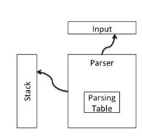
LL(1) Parsing Algorithm
Initial Configuration: Stack=S, Input=w$, where S is the Start Symbol, $= end of the marker.
Repeat{
Let X be the top of stack Symbol
Let a be the next input symbol /* it may have $*/
if X is a terminal symbol or $ then
if X==a then
{
pop X from stack;
remove a from input;
}
else error();
else /* X is a non terminal*/
if M[X,a]=X→Y₁Y₂…Y_{k} then
{
pop X from stack;
push Y_{k}, Y_{k-1}….Y₁ onto stack;
}
} until stack has empted.

Slide 13
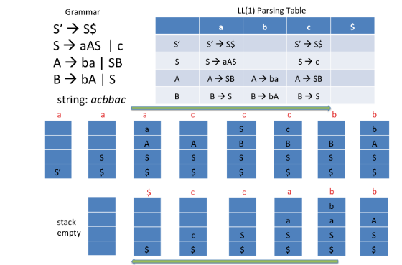
LL(1) Parsing example

Slide 14
References
Aho, A. V., & Ullman, J. D. (1977). Principles of Compiler Design.Addison-Wesley Longman Publishing Co., Inc.
Jeffrey, A. V., Ullman, J. D. & Sethi R. (1986). Compilers, Principles, Techniques, and Tools. Wesley.
Barrett, W. A., &amp; Couch, J. D. (1988). Compiler construction: theory and practice. Galgotia.
Tremblay, J. P., &amp; Sorenson, P. G. (1985). Theory and Practice of Compiler Writing. McGraw-Hill, Inc.
Gries, D. (1987). Compiler construction for digital computers. NewYork: Wiley.

